Slide 1
Best Practices in Patients with Low White Blood Cell Counts
Jose N Galeas MD

Slide 2
Objectives
- Define leukopenia and its clinical significance
- Identify signs and symptoms
- Discuss comprehensive diagnostic workup
- Outline management strategies
- Address Duffy Null phenotype
- Apply Choosing Wisely principles

Slide 3
Definition of Leukopenia
- WBC count <4,000 cells/µL
- Subtypes: Neutropenia (<1,500 neutrophils/µL), Lymphopenia (<1,000 lymphocytes/µL)
- Common causes: infections, bone marrow disorders, autoimmune conditions, medications

Slide 4
Causes of Leukopenia
- Primary: Congenital disorders (e.g., Kostmann syndrome)
- Secondary: Infections, drugs, autoimmune diseases, nutritional deficiencies, malignancies

Slide 5
Neutropenia
Neutrophil count less than 1.5x10⁹/L
Severity is important
1.0x10⁹/L
0.5x10⁹/L

Slide 6
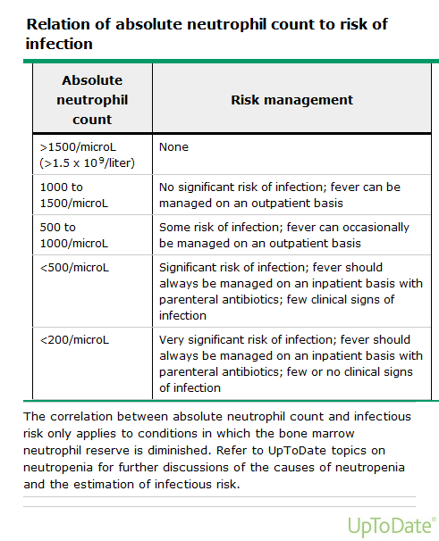

Slide 7
Clinical manifestations
Systemic illness
Mostly asymptomatic
>1.0x10⁹/L
Neutropenia of short duration
Pneumonia
Pharyngitis
Infection of skin

Slide 8
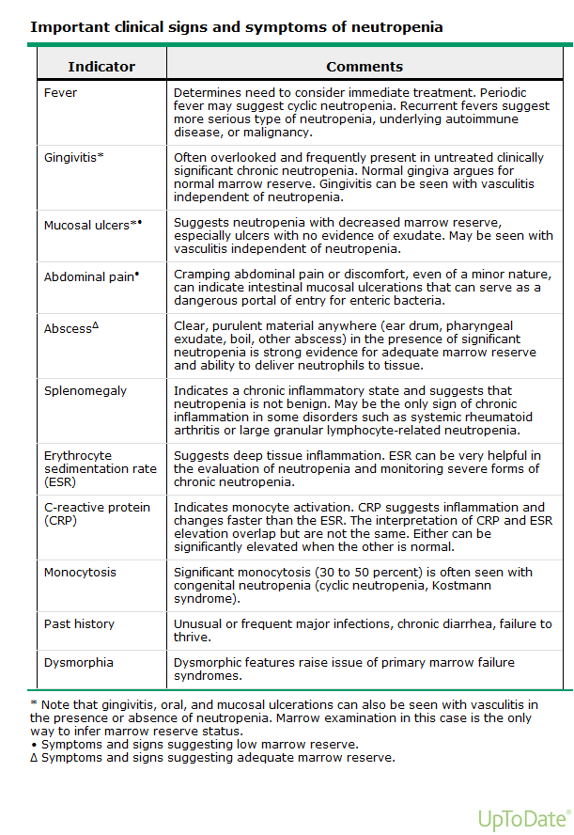

Slide 9
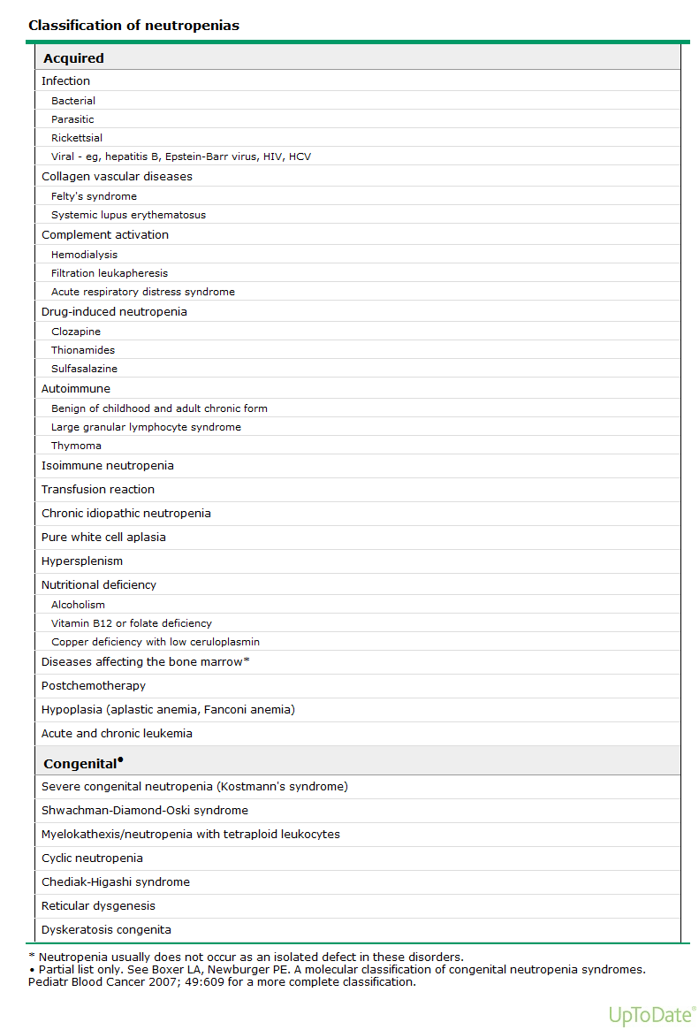

Slide 10
Abnormalities in the bone marrow compartment
Bone marrow injury
Drugs and cytotoxic agents
Radiation
Chemicals
Benzene, nitrous oxide, DDT, dinitrophenol
Immunologically mediated
Rheumatic disorers

Slide 11
Abnormalities in the bone marrow compartment
Bone marrow injury
Bone marrow replacement (infitrative dis.)
Malignancies
Fibrosis
Inherited neutropenia syndromes
Cyclic neutropenia, severe congenital neutropenia, Shwachman-Diamond syndrome

Slide 12
Maturation defects
Acquired
Folic acid deficiency
Vitamin B₁₂ deficiency
Clonal disorders
Myelodysplastic syndromes
Paroxysmal nocturnal hemoglobinuria

Slide 13
Abnormalities in the extravascular compartment
Increased utilization
Severe bacterial, fungal, viral, or rickettsial infection

Slide 14
Drugs that cause neutropenia
Antiarrhytmics
Tocainide, procainamide, propranolol, quinidine
Antibiotics
Chloramphenicol, penicillins, sulfonamides, rifampin, vancomycin, isoniazid, gancyclovir
Antimalarials
Dapsone, quinine, pyrimethamine
Anticonvulsants
Phenytoin, carbamazepine

Slide 15
Drugs that cause neutropenia
Hypoglycemic agents
Tolbutamide, chlorpropamide
Antihistaminics
Cimetidine, brompheniramine, tripelennamine
Antihypertensives
Methyldopa, captopril
Anti-inflammatory agents
Ibuprofen, gold salts, indomethacin

Slide 16
Drugs that cause neutropenia
Antithyroid agents
Prophylthiouracil, methimazol, thiouracil
Diuretics
Hydrochlorothiazide, chlorthalidone
Phenothiazines
Chlorpromazine, prochlorperazine
Cytotoxic agents
Immunosuppressive agents

Slide 17
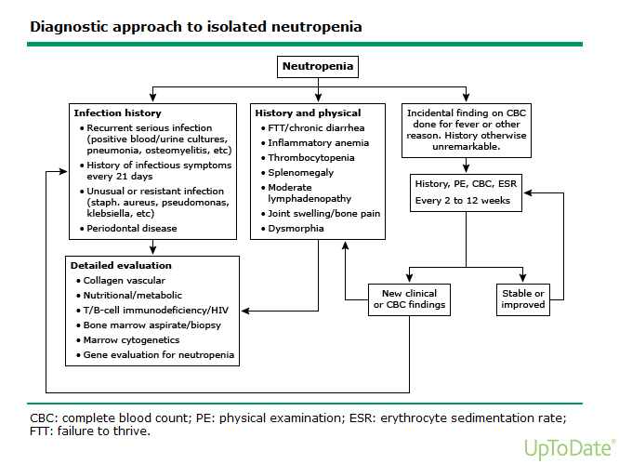

Slide 18
Diagnosis
Complete blood count
Peripheral blood smear
Fever!!!
Patient with fever and severe neutropenia

Slide 19
Diagnosis
Drug and toxin
Chronicity of neutropenia
Recurrent infections
Underlying disease
Vitamin B₁₂ and folic acid levels
Examination of bone marrow

Slide 20
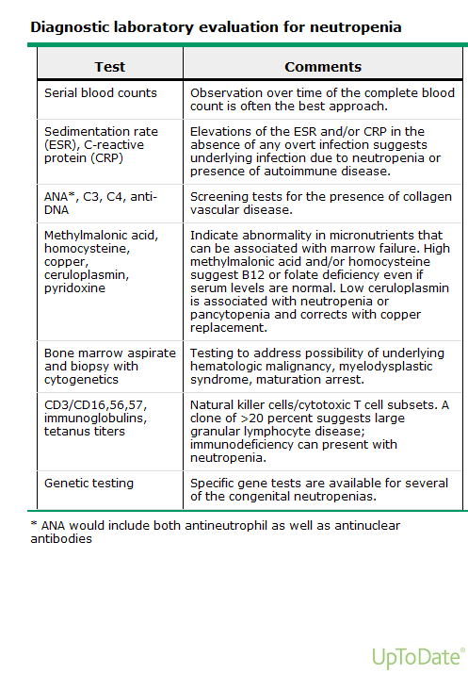

Slide 21


Slide 22
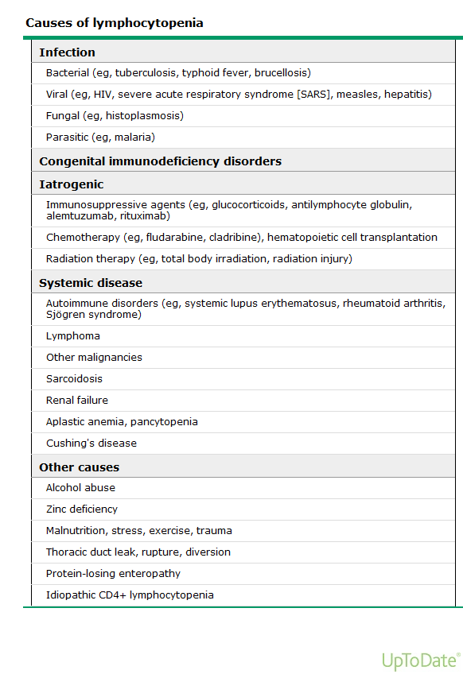

Slide 23
Comprehensive Diagnostic Workup
CBC with Differential and Platelets
Comprehensive Metabolic Panel (CMP)
Flow Cytometry
Vitamin B-12 and Folate
TSH and Copper
ANA for autoimmune screening
Immunoglobulins (IgA, IgM, IgG)
Free Kappa/Lambda Light Chains
Duffy Null Phenotype Testing

Slide 24
Duffy Null Phenotype in Neutropenia
Benign ethnic neutropenia common in individuals of African descent
Testing options:
- Genotyping: FY*BES allele (PCR/NGS)
- Serology: Duffy antigen typing
No treatment required unless symptomatic
Important to differentiate from pathological causes

Slide 25
Management Strategies
Treat underlying cause
Supportive care: G-CSF, antimicrobials
Address nutritional deficiencies
Infection prevention strategies
Patient education on benign conditions like BEN

Slide 26
Choosing Wisely Recommendations
Avoid unnecessary antibiotics
Limit routine bone marrow biopsies
Optimize vaccination schedules
Educate patients on infection prevention
Avoid overuse of G-CSF in benign cases

Slide 27
Summary and Key Takeaways
Early identification and management prevent complications
Comprehensive testing guides targeted treatment
Recognizing benign conditions prevents unnecessary interventions

